Slide 1

Case-Study – Telecom Customer Churn
Final Deliverables

Slide 2

Business Objective, Understanding and Approach
Understanding
Business Objective
After a certain period of time, the Telecom Company is facing a considerable amount of customer churn.
It’s important for the Telecom company to retain its customers not only to maintain a good flow of revenues, but also to avoid incurring costs to acquire new customers.
For reducing a future churn, we need to focus on what all the effective measures are to be taken into consideration.
The Telecom Company needs assistance in performing some quantitative analysis on the provided dataset and generate some relevant insights. This should guide the Company to first understand what factors are potentially causing churn and by taking what actions can the churn be minimized
Approach
A good starting point can be by doing the analysis on how the Churn and Non-Churn profiles are showing the results when compared with the weeks that the customers has been active.
Another approach can be by observing the insights on how the Churn and Non-Churn profiles are showing the results when compared with the various relevant attributes like average talk time, monthly bill, contract renewed etc.

Slide 3
Analysis
Data Preparation and EDA:
Uni-Variate analysis is conducted on all the relevant variables
Bi- Variate analysis is conducted on all the meaningful variables
Outliers identified in the variables are taken care of
Variable Creation and Selection:
Three new variables are created as part of Feature Engineering
Churn rate is used as a Key reference in analyzing the data over Years
Contract Renewal is also used as a reference for analysis

Slide 4
Extended Data Dictionary (EDD)
 | Variable Type | Min | Pc 1% | Pc 5% | Pc 25% | Pc 50% | Mean | Pc 75% | Pc 95% | Pc 99% | Max | % Missing values | % Unique values
Week_active | int64 | 10 | 12 | 35 | 74 | 101 | 102 | 127 | 167 | 195 | 200 | _ | 6
Conrenew_flag | int64 | 0 | 0 | 0 | 1 | 1 | 1 | 1 | 1 | 1 | 1 | _ | 0
Dataplan_flag | int64 | 0 | 0 | 0 | 0 | 0 | 0 | 1 | 1 | 1 | 1 | _ | 0
Data_usage | float64 | 0 | 0 | 0 | 0 | 0 | 1 | 2 | 3 | 4 | 5 | _ | 5
Num_cs_calls | int64 | 0 | 0 | 0 | 1 | 1 | 1 | 2 | 4 | 6 | 9 | _ | 0
Avg_talk_time | float64 | 50 | 52 | 90 | 144 | 179 | 180 | 216 | 271 | 305 | 305 | _ | 50
Avg_calls | int64 | 52 | 54 | 67 | 87 | 101 | 100 | 114 | 133 | 146 | 150 | _ | 4
Mth_bills | float64 | 14 | 26 | 33 | 45 | 54 | 56 | 66 | 88 | 99 | 100 | _ | 19
Overagefee | float64 | 0 | 4 | 6 | 8 | 10 | 11 | 12 | 14 | 16 | 18 | _ | 31
Roam_mins | float64 | 0 | 3 | 6 | 9 | 10 | 10 | 12 | 15 | 17 | 20 | _ | 5
Churn_flag | int64 | 0 | 0 | 0 | 0 | 0 | 0 | 0 | 1 | 1 | 1 | _ | 0
Key takeaways:
The Average talk time of the customers on average is found out to be around 179 minutes
The Average calls made by the customers on average is around 100
The Average monthly bill of the customers on average is found out to be around 56
Mean value of the Overage fee is around 10

Slide 5
Feature Engineering – New variables created
Sr. No | Variable Name | Variable Type | Description
1 | years_active | Numeric | A continuous variable converted to Bins based on meaningful threshold
2 | total_bill | Numeric | Combing two required attributes into single attribute
3 | avg_hours_talktime | Numeric | A continuous variable converted to Bins based on meaningful threshold
- | - | - | -
- | - | - | -

Slide 6
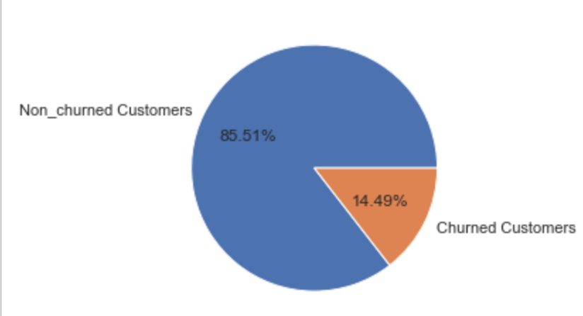
Analysis on the Customers Churn
Key Takeaways :
About 14.5% of the customers are Churning, such a Churn rate can make the Company go bankrupt.
Churn rate of 14.5% will have a huge impact on Company’s revenue.

Slide 7
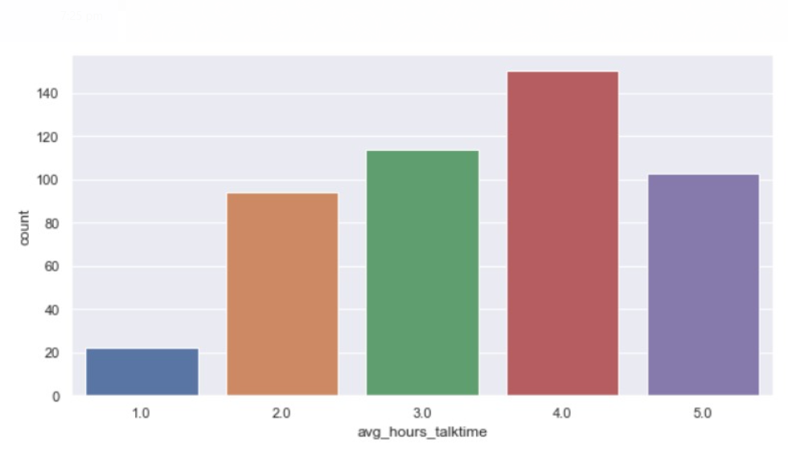
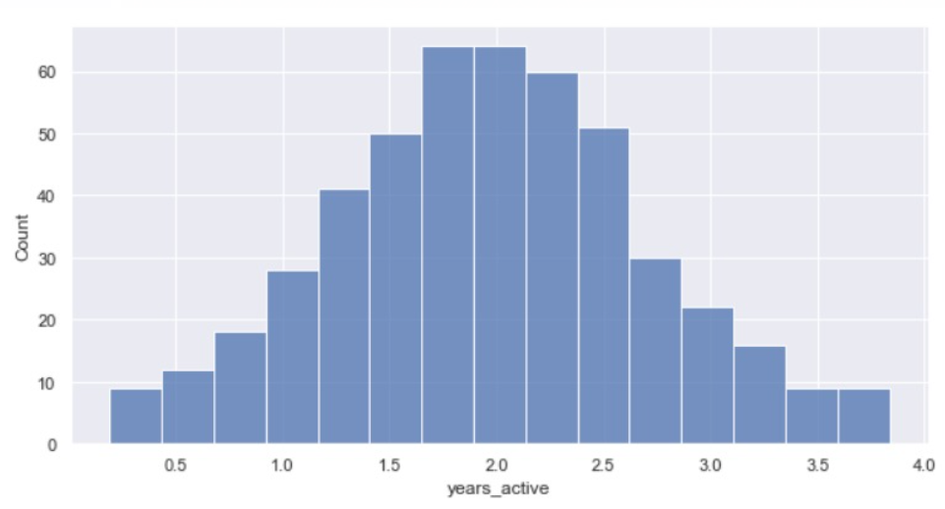
Churned customers average talk time(in hours)
Years active of Churned customers
Key takeaways:
There are more number of Churned customers who have four hours of average talk time
Key takeaways:
Most of the churned customers are active for 2 years
After 2 years active churned customers are considerably decreasing
The minimum amount of time that a churned customer is active for 6 months

Slide 8
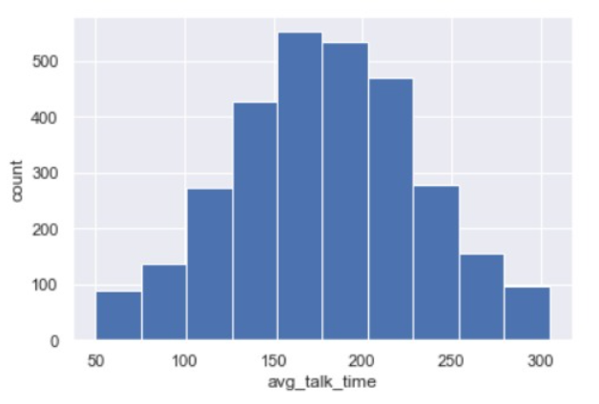
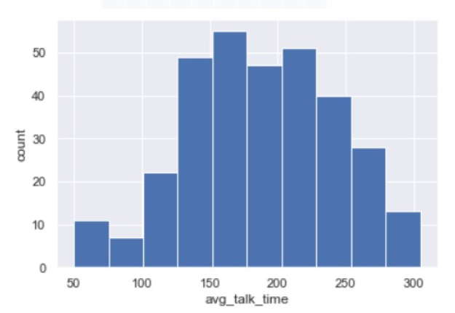
Average talk time of Churned customers
Average talk time of Non-Churned customers
Key takeaways:
The average talk time minutes in a day for Churned customers is high compared to Non-Churned customers
The major part of average talk time of Churned customers is in between 100 and 240 minutes
The major part of average talk time of Non-Churned customers is in between 130 and 230 minutes

Slide 9
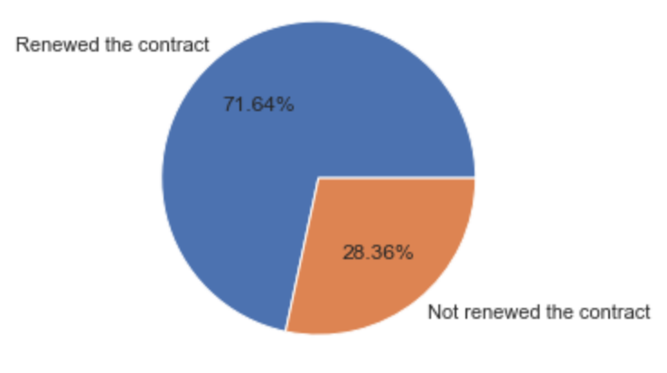
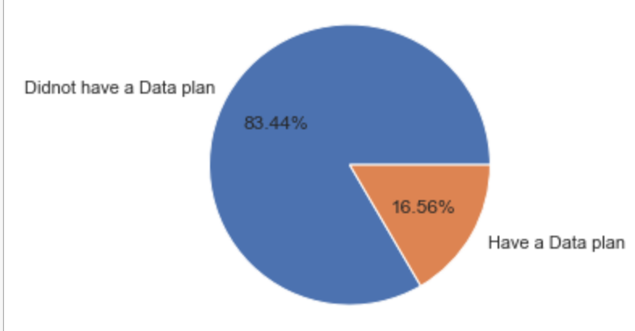
Analysis on the Contract Renewal customers
Contract renewal of Churned customers
Data plan of Churned customers
Key takeaways:
Nearly 72% of the Churned customers have renewed their contract
Nearly 17% of the Non-Churned customers have active data plan

Slide 10
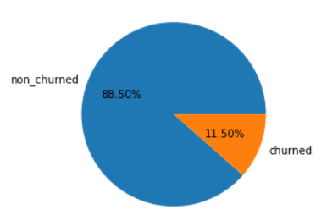
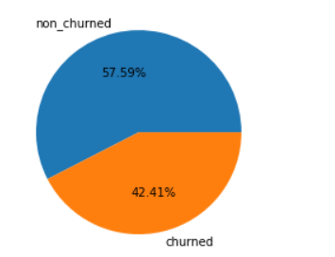
Contract Renewed Customers
Non-contract Renewed Customers
Key takeaways:
About 12% of contract renewed customers are churned and 88% are Non-churned
Key takeaways:
About 58% of Non-contract renewed customers are Non-churned and 42% are churned

Slide 11
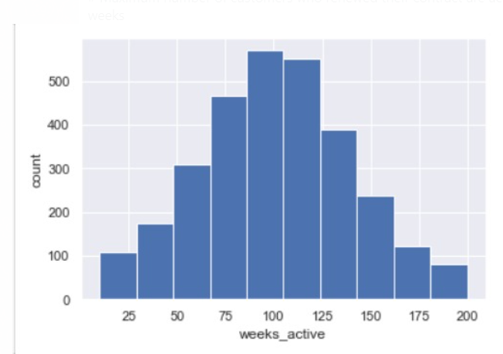
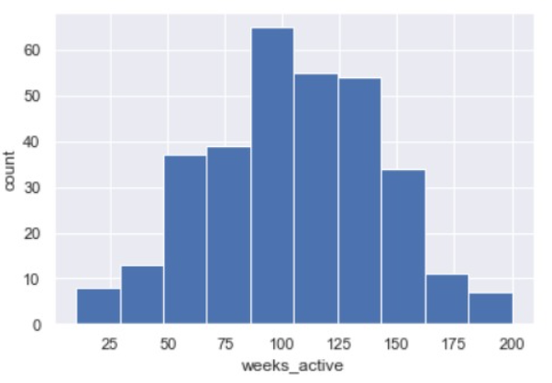
Distribution of Weeks active of the Contract renewed customers
Distribution of Weeks active of the Non Contract renewed customers
Key take aways:
Maximum number of customers who did not renewed their contract are active around 104 weeks
Maximum number of customers who renewed their contract are active around 100 weeks

Slide 12
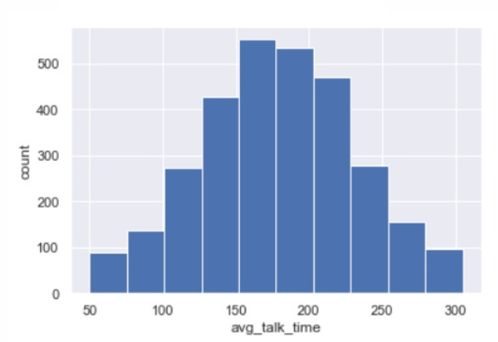
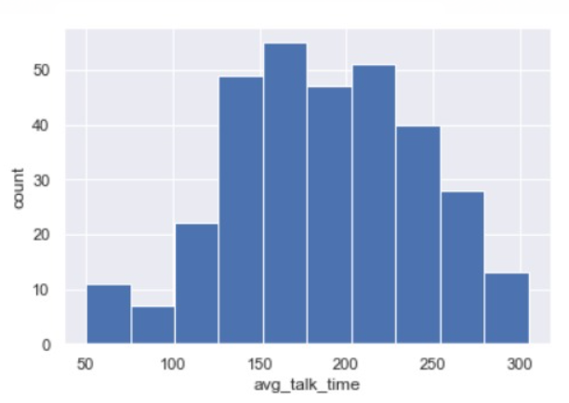
Average talk time on Contract renewed customers
Average talk time on Non-Contract renewed customers
Key takeaways:
Maximum number of customers who renewed their contract have a average talk time of 178 minutes
Key takeaways:
Maximum number of customers who did not renewed their contract have a average talk time of 187 minutes

Slide 13
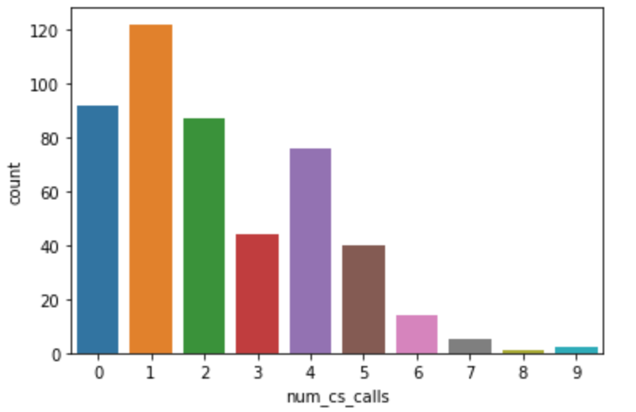
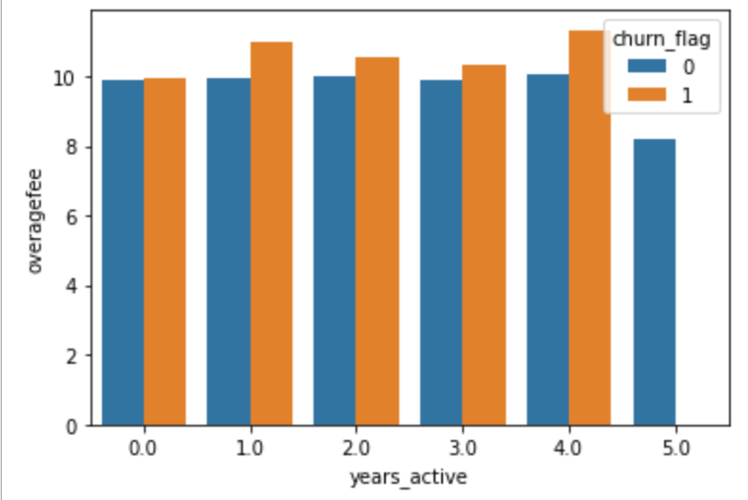
Number of Customer service calls made by churn customers
Overage fee observed for the customers in last five years
Key takeaways:
After the threshold of overage fee 10,it is observed that the churn customers are more.
It is also observed that churn customers are more in the 4th year.
Key takeaways:
Nearly 56% of churn customers making more than one customer service call.
19% of the churn customers didn’t made a single customer service call.
25% of the churn customers have made a single customer service call .

Slide 14
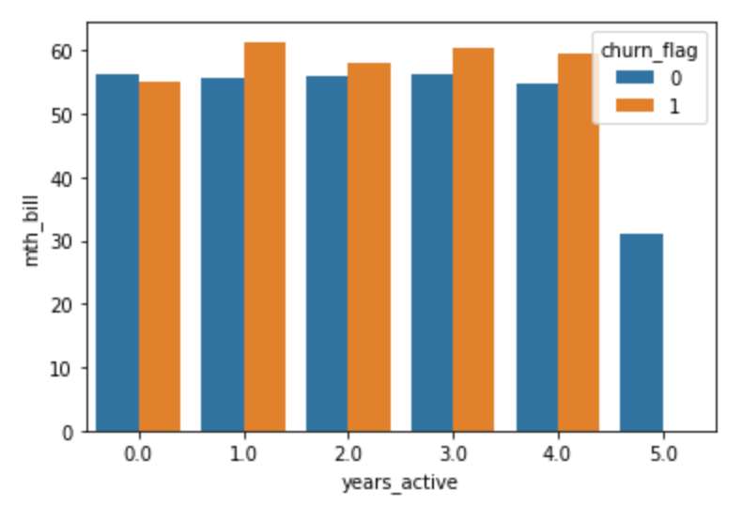
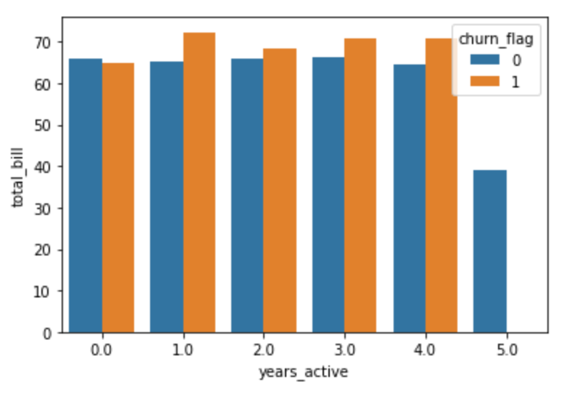
Monthly bill observed for the customers in last five years
Total bill generated for the customers
Key takeaways:
The monthly bill generated for Churned customers is more than of Non-churned customers.
After the threshold bill 56 the Churned customers are more
Key takeaways:
The company is loosing high valued customers
The total bill of Churned customers is more compared to Non-churned customers

Slide 15
Key Takeaways and Recommendations
Key Takeaways from the Analysis :
14.5% of the total customers are churning.
Majority of the customers are churning after the contract renewal.
Nearly 56% of the churned customers made more than one customer service call.
The company is loosing high valued customers.
83% of the churned customers didn’t have an active data plan.
Majority of the churned customers have higher average talk time.
About 19% of the customers are churning without even making a single call to the customer care service
Final Recommendations :
Customer care service has to solve the customer problems within a call.
Providing a minimum data plan or discounts on data plan may reduce future churn.
Customers have to be educated to contact customer service when they are facing an issue.
Providing better service for contract renewed customers may reduce the churn.
Provide vouchers or value added plans for the customers who are having higher average talk time.

Slide 16


